Slide 1

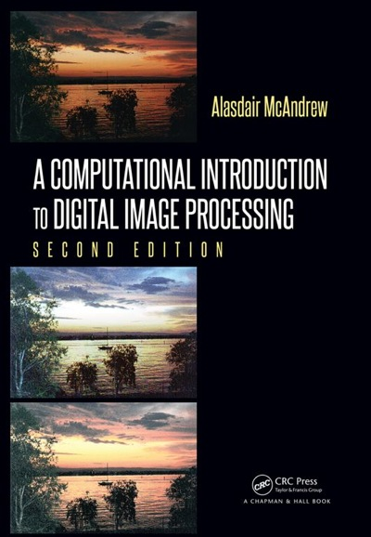
Chapter 9
Image Segmentation

Slide 2

Contents
Introduction
Thresholding
Applications of Thresholding
Choosing an Appropriate Threshold Value
Adaptive Thresholding
Edge
Weiner Filtering

Slide 3
Contents
Introduction
Thresholding
Applications of Thresholding
Choosing an Appropriate Threshold Value
Adaptive Thresholding
Edge Detection
Derivatives and Edges
Second Derivatives
The Canny Edge Detector
Corner Detection
The Hough and Radon Transforms

Slide 4
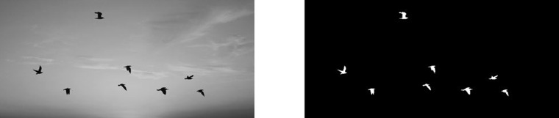
Introduction
Segmentation: the operation of partitioning an image into component parts or into separate objects.
Thresholding: A vital part of segmentation where objects are isolated from the background
Important component of robot vision
Figure 9.1: Thresholded image of flying birds

Slide 5

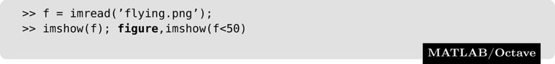
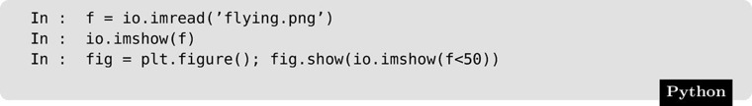
Thresholding
Thresholding can be done very simply in any of our systems. Suppose we have an 8-bit image, stored as the variable X. Then the command
will perform the thresholding. For example, consider an image of some birds flying across a sky; it can be thresholded to show the birds alone in MATLAB or Octave:

Slide 6
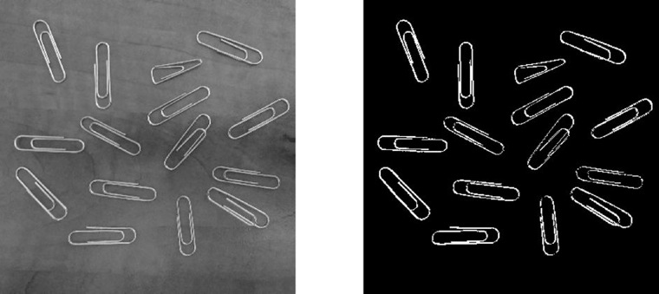
Thresholding
Figure 9.2: Thresholded image of paperclips

Slide 7
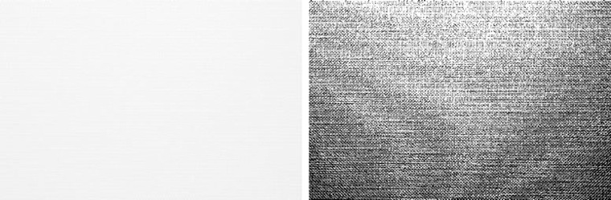
Thresholding
Thresholding also provides a way of showing hidden aspects of an image
Ex. Handmade paper (Figure 9.3)
Figure 9.3: The paper image and result after thresholding

Slide 8
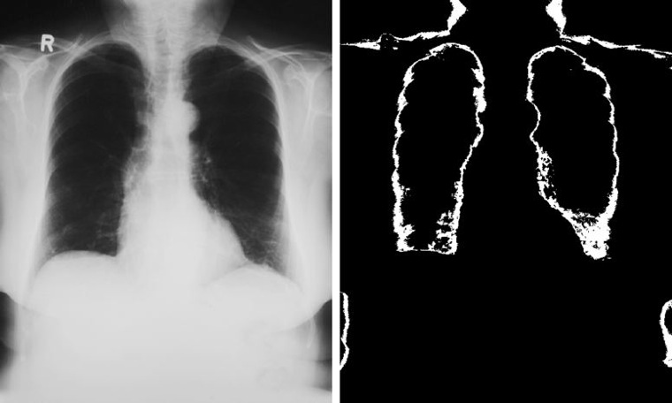
Double Thresholding
Choose two values T₁ and T₂ and apply a thresholding operation
A pixel becomes
White: if gray level is between T₁ and T₂
Black: gray level is otherwise
Figure 9.4: The image xray.png and the result after double thresholding

Slide 9
Double Thresholding
Try It:
MatLab/Octave:
x = imread('xray.png');
imshow(x);
dt = (x > 50 & x < 80);
imshow(dt)
Python:
import skimage.io as io
x = io.imread('xray.png')
dt = ((x > 50) & (x < 80))
imshow(dt)

Slide 10
Applications of Thresholding
When can Thresholding be useful?
Remove unnecessary detail
Bring out hidden detail
Remove a varying background

Slide 11
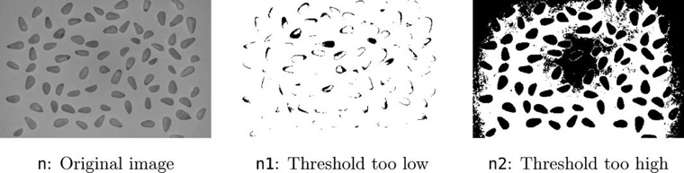
Choosing an Appropriate Threshold Value
Figure 9.5: Attempts at thresholding

Slide 12
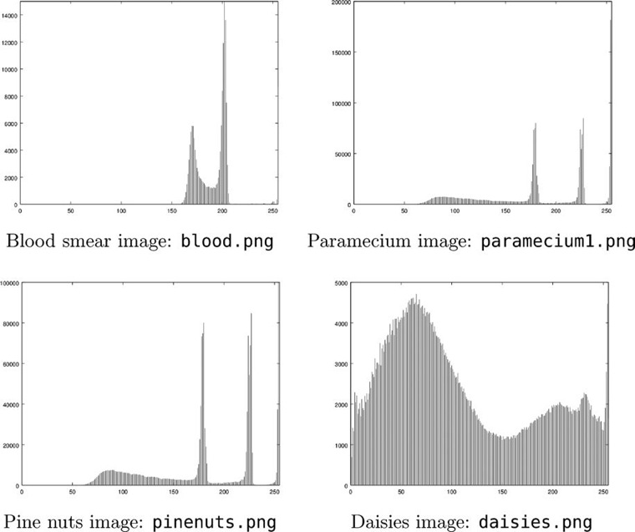
Choosing an Appropriate Threshold Value
Figure 9.6: Histograms
Third peak at far right
Difficult to find appropriate split
Histogram is not the best method for finding a threshold value

Slide 13
Choosing an Appropriate Threshold Value
Two methods for choosing the best threshold:
Otsu’s Method
First described by Nobuyuki Otsu in 1979
Maximizes inter-class variance
The ISODATA Method
Iterative Self-Organizing Data Analysis Technique A
Both methods perform statistical analyses on the pixel data to determine the best threshold value.

Slide 14
Choosing an Appropriate Threshold Value
MATLAB and Octave graythresh function:
Parameter ‘otsu’ for Otsu's method
Parameter ‘intermeans’ for ISODATA method
Python filter module of skimage:
Method threshold_otsu
Method threshold_isodata

Slide 15
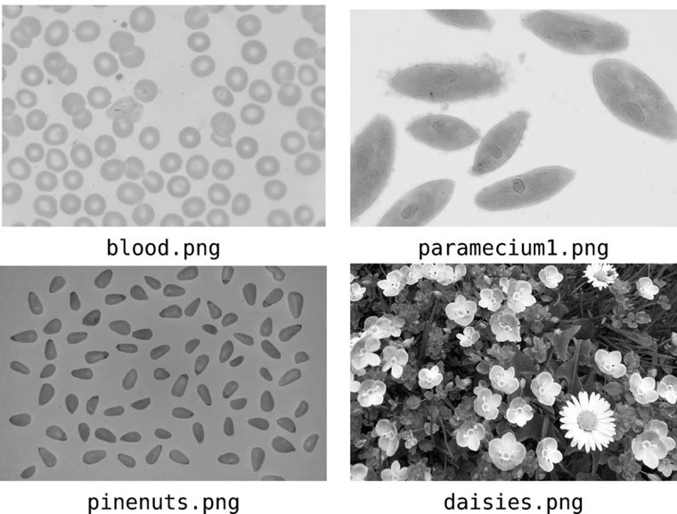
Otsu’s Method
Figure 9.9: Images to be thresholded

Slide 16
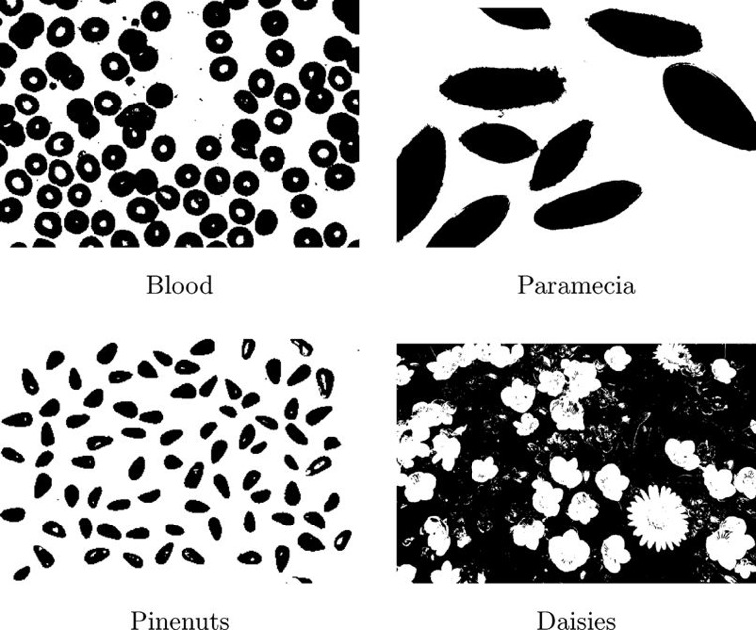
Otsu’s Method
Figure 9.10: Thresholding with values obtained with Otsu's method

Slide 17
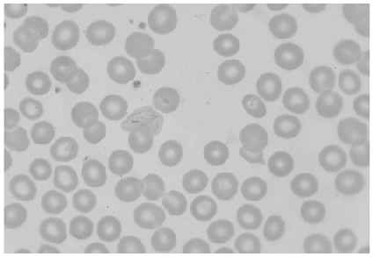
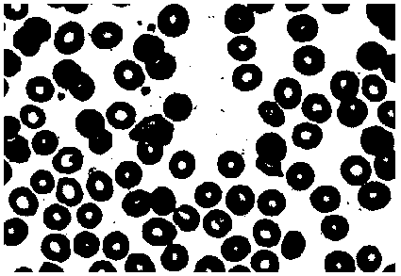
Otsu’s Method – Try It
MatLab/Octave:
b = imread('blood.png');
imshow(b);
t = graythresh(b, 'otsu')
int_t = t * 255
bt = b > t_int;
imshow(bt);
Python:
import skimage.io as io
import skimage.filters as fl
b = io.imread('blood.png')
imshow(b)
t = fl.threshold_otsu(b)
bt = (b > t)
imshow(bt)

Slide 18
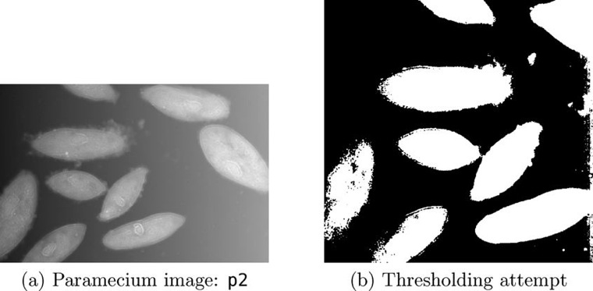
Adaptive Thresholding
Sometimes it is not possible to obtain a single threshold value that will isolate an object completely
This may happen if both the object and its background vary.
Figure 9.11: An attempt at thresholding

Slide 19
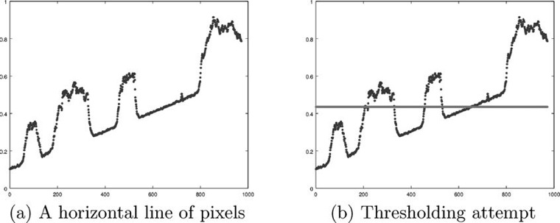
Adaptive Thresholding
Figure 9.12: An attempt at thresholding—functional version

Slide 20
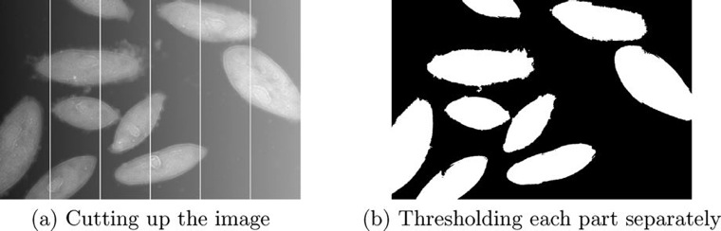
Adaptive Thresholding
Adaptive Thresholding: Cut the image into small pieces, and apply thresholding to each piece individually.

Slide 21
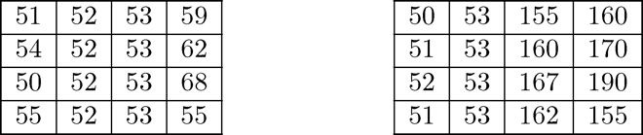
Edge Detection
Edges contain some of the most useful information in an image
Edges can be used to
Measure the size of objects in images
Isolate particular objects from their backgrounds
Reorganize or classify objects
Edge: a local discontinuity in the pixel values which exceeds a given threshold (an observable difference in pixel values)
Figure 9.14: Blocks of pixels

Slide 22
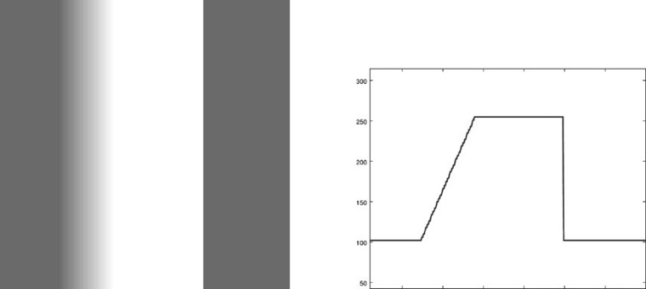
Derivatives and Edges
Fundamental Definitions
Ramp edge: gray values change slowly
Step (Ideal) edge: gray values change suddenly
Figure 9.15: Edges and their profiles

Slide 23
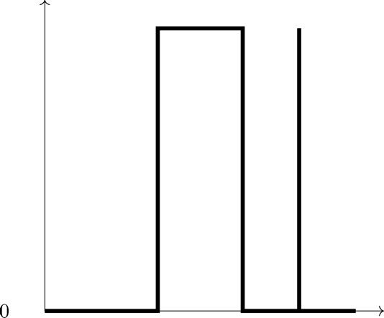
Derivatives and Edges
Figure 9.16: The derivative of the edge profile
The derivative, as expected, returns zero for all constant sections of the profile, and is non-zero (in this example) only in those parts of the image in which differences occur

Slide 24
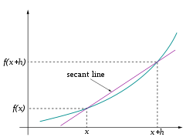
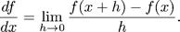
Return of Calculus!!!!

Slide 25

Return of Calculus!!!!
In an image, the smallest possible value of h is 1, the difference between the two adjacent pixels. A discrete version of the derivative expression:

Slide 26


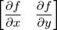
Return of Calculus!!!!
Other expressions for the derivative:
Discrete counterparts:
For an image, with two dimensions, we use partial derivatives; an important expression is the gradient:

Slide 27
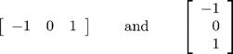
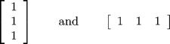
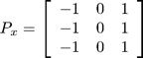
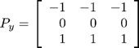
Edge Detection Filters
Using the expression f(x + 1) − f(x − 1) for the derivative, leaving the scaling factor out, produces horizontal and vertical filters:
Will find vertical and horizontal edges but produce “jerky” edges; use smoothing in the opposite direction
Combined into one filter each, known as the Prewitt Filters:
Vertical edges Horizontal edges

Slide 28
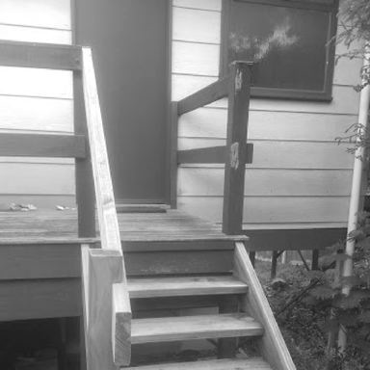
Prewitt Filters
Figure 9.17: A set of steps: A test image for edge detection

Slide 29
Prewitt Method – Try It
MatLab/Octave:
s = imread('stairs.png');
imshow(s);
px = [-1 0 1; -1 0 1; -1 0 1];
py = px';
sx = imfilter(s, px);
imshow(sx);
sy = imfilter(s, py);
imshow(sy);
Python: ????
import skimage.io as io
import skimage.filters as fl
s = io.imread('stairs.png')
imshow(s)
sx = fl.prewitt_h(s)
io.imshow(sx)
sy = fl.prewitt_v(s)
io.imshow(sy)

Slide 30
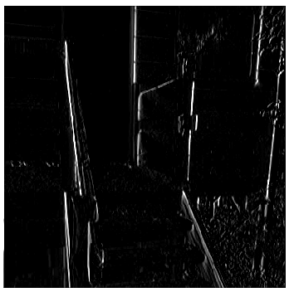
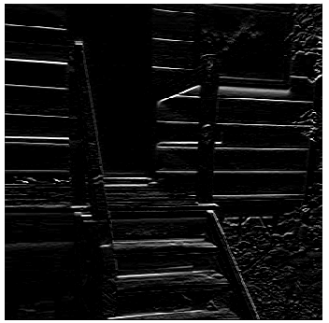
Prewitt Filters
MatLab/Octave:

Slide 31
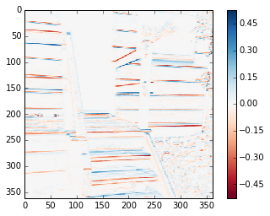
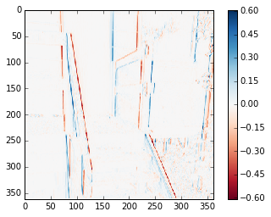
Prewitt Filters
Python:
sx
sy

Slide 32
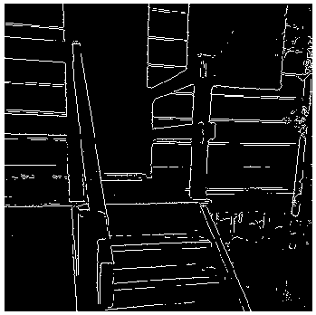
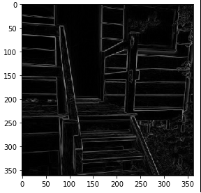
Prewitt Filters
MatLab/Octave All edges:
edge_p = edge(s, 'prewitt');
imshow(edge_p);
Python:
import numpy as np
edge_p = np.sqrt(sx**2 + sy**2)
io.imshow(edge_p);
Performs edge detection and thresholding

Slide 33
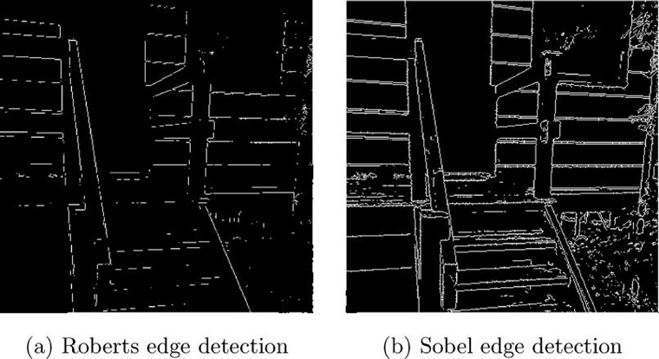
Roberts and Sobel Filters
Figure 9.21: Results of the Roberts and Sobel filters

Slide 34
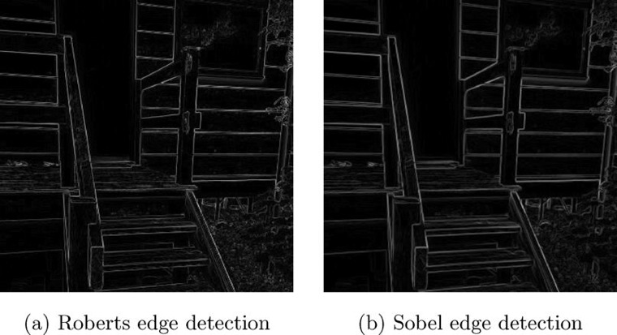
Roberts and Sobel Filters
Figure 9.22: Results of the Roberts and Sobel filters in Python

Slide 35
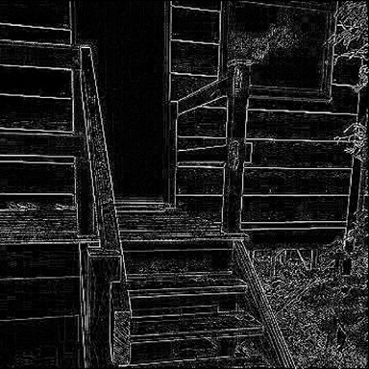
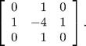
Laplacian Filter
Laplacian
The sum of second derivatives in both directions
Isotropic filter: invariant under rotation
Extremely sensitive to noise
Discrete Laplacian Filter
Figure 9.24: Result after filtering with a discrete Laplacian

Slide 36
Laplacian Filter
Laplacian
The sum of second derivatives in both directions
Isotropic filter: invariant under rotation
Extremely sensitive to noise
Discrete Laplacian Filter
Figure 9.24: Result after filtering with a discrete Laplacian

Slide 37
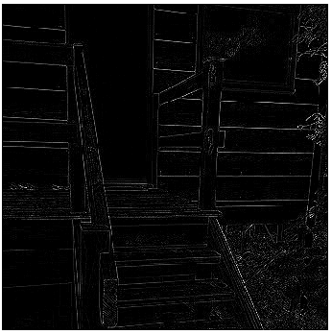
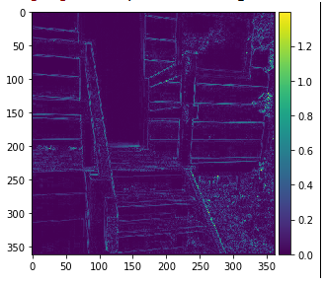
Laplacian Filter
MatLab/Octave:
lap = fspecial('laplacian', 0)
s_lap = imfilter(s, lap);
imshow(s_lap);
Python: ????
import skimage.util as ut
s2 = ut.img_as_float(s)imshow(s_lap)
s_lap = abs(fl.laplace(s2))
io.imshow(s_lap)

Slide 38
The Canny Edge Detector
Canny designed his method to meet 3 criteria for edge detection:
Low error rate of detection. (It should find ALL edges, and only edges)
Localization of edges. (Distance between actual edges in the image and edges found by this algorithm should be minimized)
Single response. (Algorithm should not return multiple edge pixels when only a single edge exists)

Slide 39
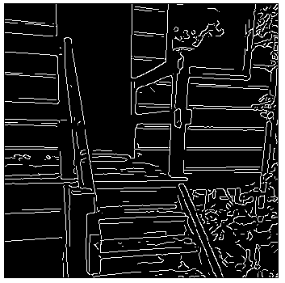
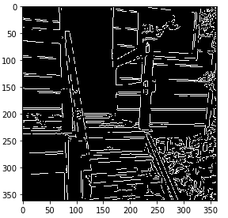
The Canny Edge Detector
MatLab/Octave:
sc = edge(s, 'canny');
imshow(sc)
Python:
import skimage.feature as ft
sc = ft.canny(s)
io.imshow(sc)

Slide 40

Corner Detection
Corners: a place where there are two edges in significantly different directions

Slide 41
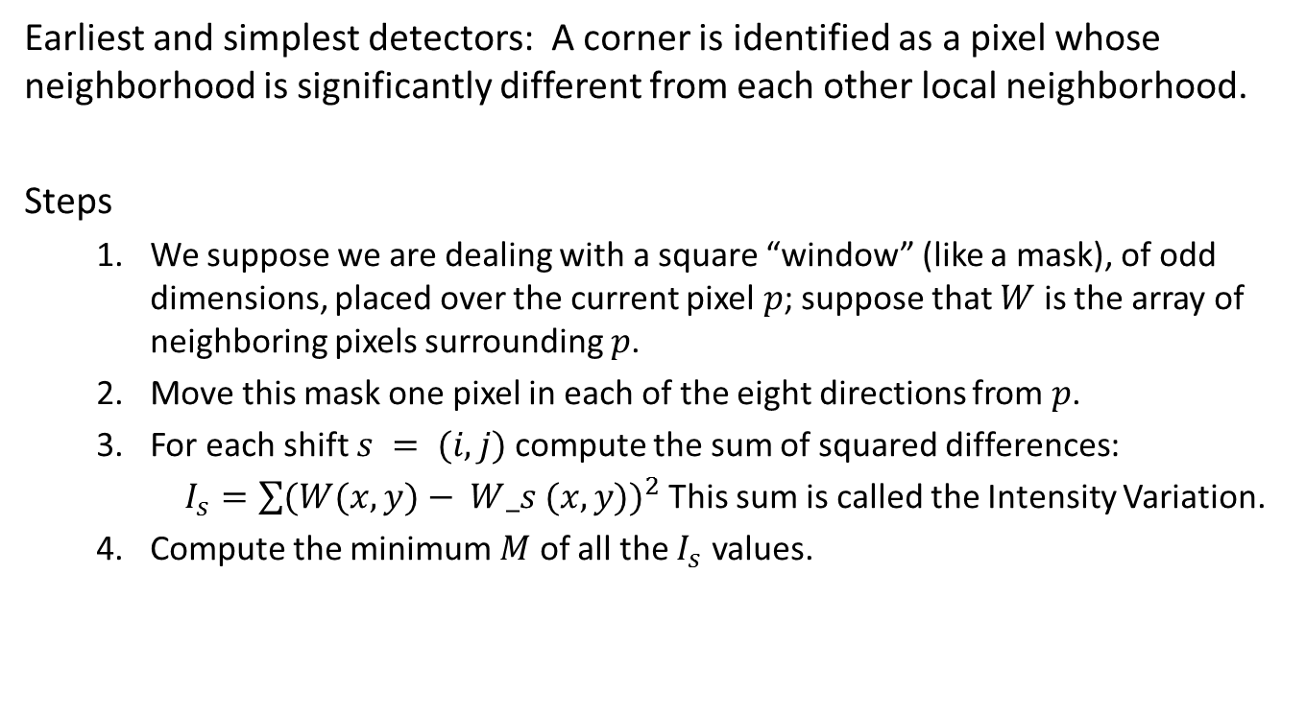
Moravec Corner Detection
Earliest and simplest detectors: A corner is identified as a pixel whose neighborhood is significantly different from each other local neighborhood.
Steps
We suppose we are dealing with a square “window” (like a mask), of odd dimensions, placed over the current pixel$p$; suppose that $W$ is the array of neighboring pixels surrounding $p$.
Move this mask one pixel in each of the eight directions from $p$.
For each shift $s = (i, j)$compute the sum of squared differences:
$I_{s}=\sum{{(W(x, y)− W_s (x, y))}^{2} }$This sum is called the Intensity Variation.
Compute the minimum $M$ of all the $I_{s}$ values.

Slide 42
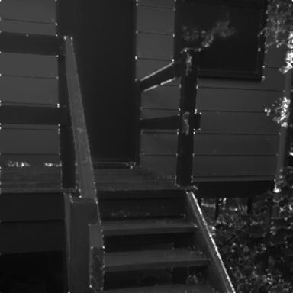
Moravec Corner Detection
Figure 9.33: Moravec corner detection

Slide 43
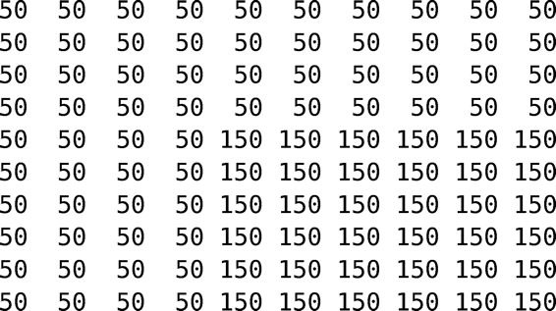
Corner Detection
Figure 9.34: A simple image with one corner

Slide 44
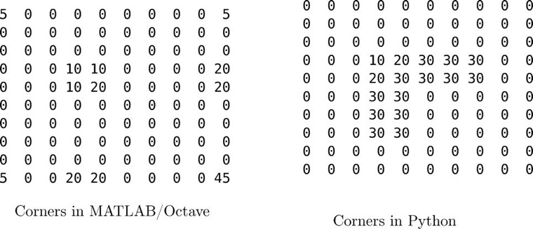
Corner Detection
Figure 9.35: Moravec detection in MATLAB, Octave, and Python compared

Slide 45
Harris-Stephens Detector
Designed to alleviate some of the problems with Moravec’s method
Based on using the first order Taylor approximation for a function of two variables
Given the eigenvalues, we distinguish 3 cases
Both are large. This corresponds to not much change in any direction, or a low frequency component of the image.
One is large and the other is small. This corresponds to an edge in that direction.
Both are small. This corresponds to change in both directions, so it may be considered a corner.

Slide 46
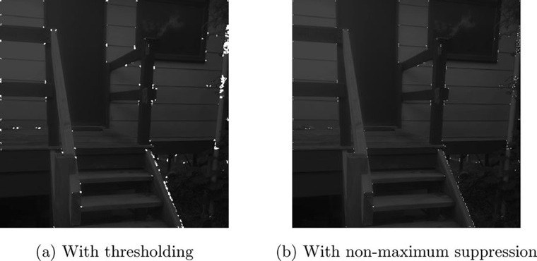
Harris-Stephens Detector
MATLAB contains a Harris-Stephens implementation in the corner function, and Python with the corner_harris method in the skimage.feature module.
Figure 9.37: Harris-Stephens corner detection

